Slide 1

Revenue Cycle Management (RCM)
Improve your Performance
Sarah Barker

Slide 2
What is RCM?
Revenue Cycle Management is a CureMD Billing Service
The Services that could be included are:
  Charge Entry
  Claim Submission
  Patient Eligibility
  Claim Scrubbing
  Rejection & Denial Management
  Payment Post ( ERAs & EOBs)
  Patient Statements
  Financial Reporting
Grow
effortlessly
Get paid
more
Get paid
faster

Slide 3
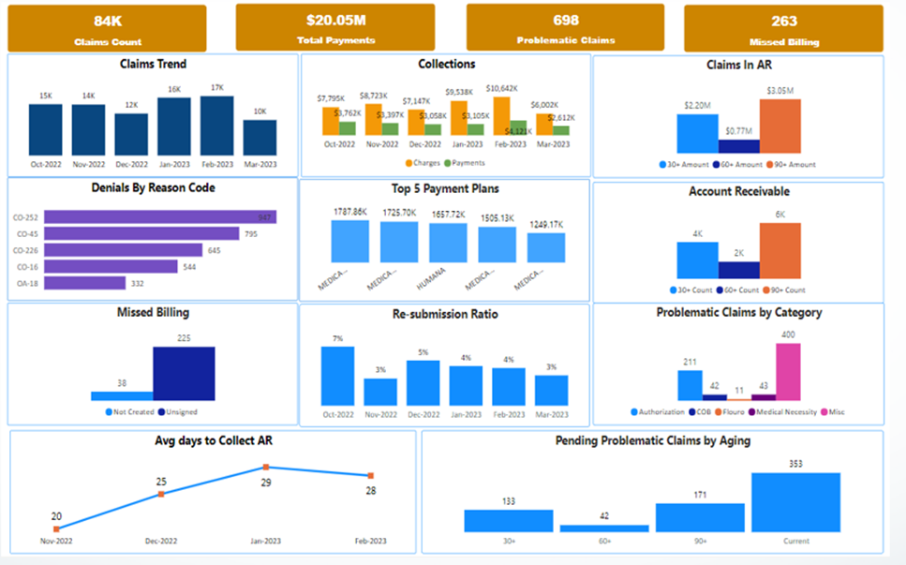
Benefits of RCM
Financial Performance Management
Management Reports
Dedicated Account Managers for RCM
Weekly or Biweekly Calls & Practice Analysis
RCM Analytics to See Trends and Take Proactive Actions
Under Payment Analysis
Resource Enhancement
Financial Growth
Community Reach
Emergency Readiness
Notes:
Financial performance reports are tailored to your needs – From standardized reports available in our PM system to Izenda customized different layers of reports and power BI dashboards, we’ve got you covered!

Slide 4

CureMD RCM Services Overview
A singular, trusted partner for your end-to-end RCM service needs
Pre-Claim Services
Patient Care Coordination
Claims Processing
Fee Schedule Review and Analysis
Claims Scrubber
Secondary and Tertiary Insurance Billing
Rejection Handling
Cross Over Claims
Overdue/No Response Claims
Credentialing
Recredentialing
Contract Management
Assistance with EDI, ERA, and Provider Enrollments
Benefit Verification
Prior Authorization
Eligibility Verification

Slide 5


CureMD RCM Services Overview
Submit accurate, clean claims with confidence
Charge Entry/ Claim Submission
Payment Posting
Charge Entry
Electronic and Paper Claims Submission
Paperless Paper Claims
Charge Audit Compliance
EOB Review
EOB Posting
ERA Posting
EOB/ERA Reconciliation
Patient payments Posting
Refunds

Slide 6

CureMD RCM Services Overview
Submit accurate, clean claims with confidence
Accounts Receivable Management
Denial Review and Management
Appeal of all Denied or Low Paid Claims
Extensive Insurance Follow Up
Patient Statement Processing
Back Billing/AR Recovery

Slide 7

Adapting RCM: A Strategic Plan
The Roadmap for Success with RCM
  Provider Credentials:
    Ensure Licensing and Certification
  Insurance Contracts:
    Partner with Major Insurers (Medicare, Medicaid, Commercial)
  EHR Integration:
    Streamline Documentation Processes
  Billing Expertise:
    Staff Training in Charge Entry and Claim Submission
  Compliance:
    Maintains HIPAA and State Regulations
This Photo by Unknown Author is licensed under CC BY-NC
This Photo by Unknown Author is licensed under CC BY-NC

Slide 8
RCM Responsibilities
Client
CureMD
Registering Patients
Creating eSuperbills/Charges
Coding/Billing Information
  Adding/Updating Fee Schedules, Modifiers, ICD 10 Importation
Exceptions Handlings
  Missing Patient Information
  Insurance Information
Charge Validation/Scrubbing
Claim Submission
Payment Posting from ERAs
  Primary
  Secondary
  Tertiary
Insurance Aging

Slide 9
What makes Claim Submission difficult for you?

Slide 10

Common Billing Errors
Insurance Eligibility
Medical Coding Accuracy
Incorrect Unit Specifications
NDC Codes
Incongruence Between Provider Status and Insurance Affiliation
Place of Service (POS) Discrepancies

Slide 11
Problem List Management
Who here knows what the Problem List is used for?
Who here currently uses the Problem List?
Abides by various global regulations tailored to each client
Denials will be placed on list for correction before re-submission
Designated Personal (PHD Employee) will be promptly notified by RCM Team
Communication between RCM and the PHD is vital for success!

Slide 12
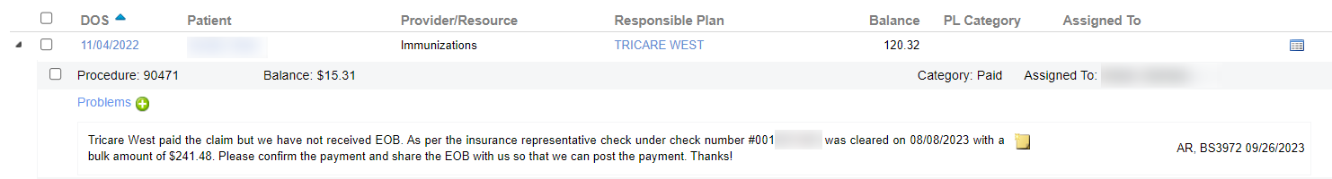
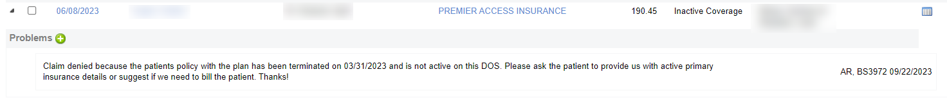
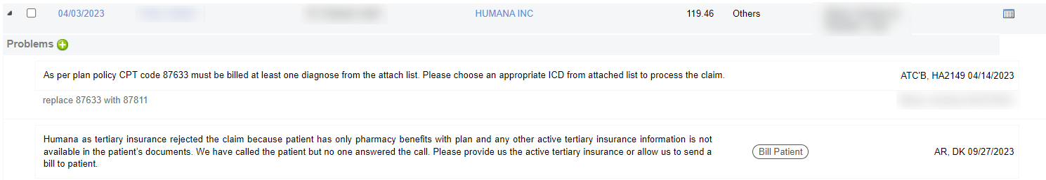

Slide 13

Complete Control Over Revenue Drainage Factors
What does Revenue Drainage mean for you?
Never Billed Claims
Pending ERAs
Rejected Claims
Overdue Claims
No Response Claims
Insurances Available but Billed to Patient

Slide 14
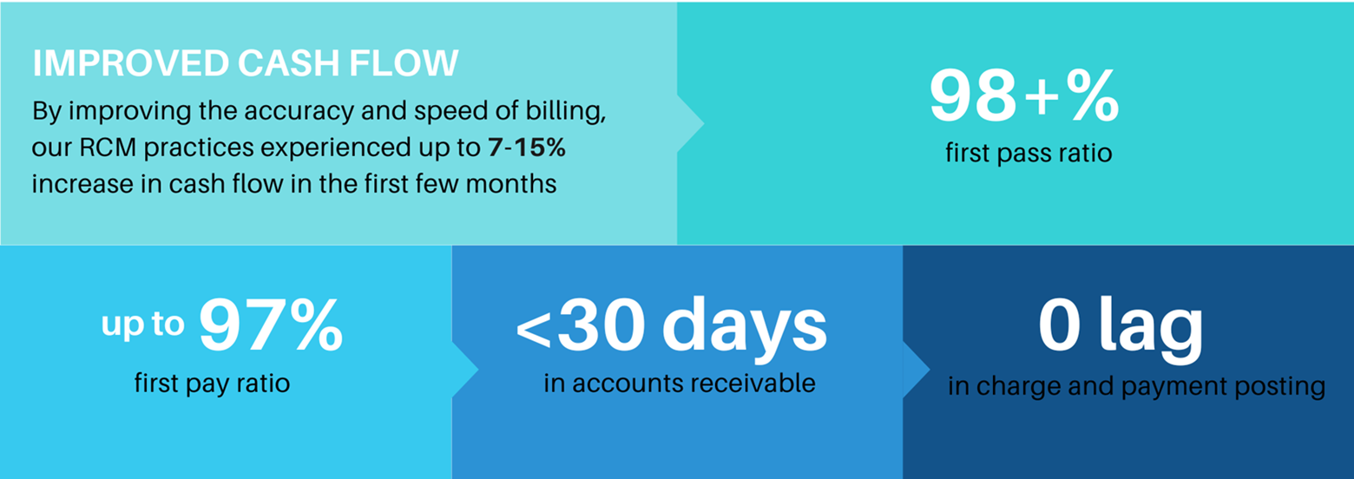
CureMD Billing Facts
The US healthcare system loses up to $935 million a week because of medical billing errors.(Forbes)
Over 25% of all medical billing errors are due to typos
Automating billing workflows with CureMD can reduce processing time by 48%. (3rd party Case Study)

Slide 15
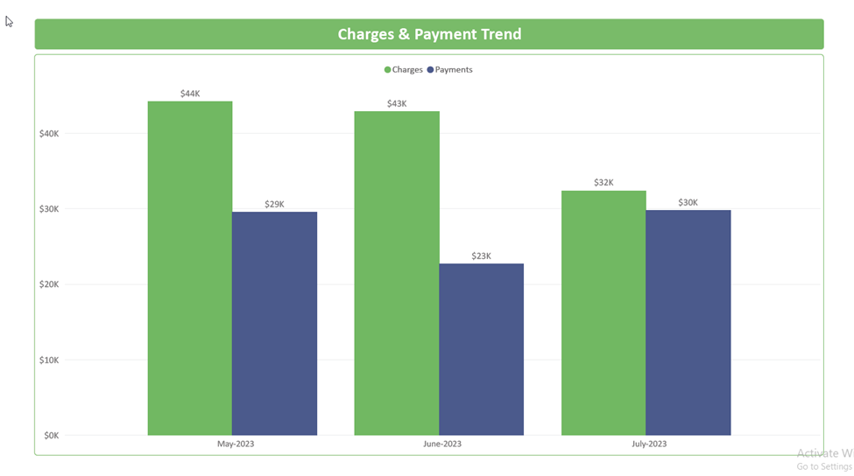
CureMD RCM FAQs
CureMD RCM has streamlined the billing of many PH clients from their superbills, charges, payments on time, denial management, problematic claims, and rules to identify possible errors and their fixes

Slide 16
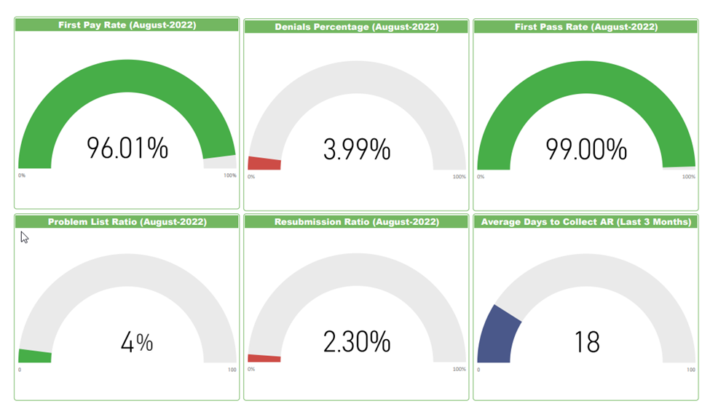
CureMD RCM FAQs
Our AI Tool helps our RCM clients minimize errors & denials prior to claim submission.

Slide 17
Is RCM For You?

